Slide 1
Cancer and Survival Rates among Firefighters and Other Responders
July 27, 2023 WTC Responder Health Program Presentation
Washington DC
David Prezant, MD, Director WTC Health Program at Fire Dept City of New York (FDNY)
Chief Medical Officer, FDNY
Special Advisor on Health Policy to the Fire Commissioner
Professor of Medicine at Albert Einstein College of Medicine

Slide 2
WTC Health Program and the
Career Firefighter Health Study
Collaboration between FDNY, Chicago, Philadelphia and San Francisco
Joint Labor-Management-Government (NIOSH) Initiative
We know that cancer rates are increased in the cohorts and also know there is a high prevalence of other chronic conditions
Aims
  Identify prevalence and mortality rates in WTC exposed firefighters and in career firefighters from Chicago, Philadelphia and San Francisco
  Provide a more appropriate comparison control group for WTC firefighter studies
    Thereby differentiating the impact of WTC exposure from usual firefighter exposures
    “Accounting” for the Healthy Worker Effect on Mortality
    Reducing the impact healthcare disparities, access and possibly surveillance bias
Investigators include: Robert D Daniels, Charles B Hall, David G Goldfarb, David J Prezant,, Joke Salako, Ankura Singh, Suzanne Triplett, Mayris P Webber, and Rachel Zeig-Owens

Slide 3
WTC & Career Firefighter Health Study Cancer Results
WTC vs. Non-WTC
 | Male WTC-exposed FDNY firefighters actively employed on 9/11/2001 | Male non-FDNY, non-WTC-exposed firefighters actively employed on 9/11/2001 3 City Fire Departments
Total N | 10,786 | 8,813
Age on 9/11, mean ± SD | 40.4±7.5 | 43.9±9.2
Race/ethnicity, N (%)
Non-Hispanic White | 10,121 (93.8) | 6,117 (69.4)
Non-Hispanic Black | 282 (2.6) | 1,589 (18.0)
Hispanic | 353 (3.3) | 736 (8.3)
Othera | 30 (0.3) | 371 (4.2)
Smoking status, N (%)
Current | 373 (3.5)b | 189 (6.6)c
Former | 3,233 (30.2)b | 1,056 (37.0)c
Never | 7,117 (66.4)b | 1,611 (56.4)c
WTC exposure/site arrival time, N (%)
Morning of 9/11 | 1,741 (16.1)
Afternoon of 9/11 | 5,683 (52.7)
9/12/2001 | 1,873 (17.4)
9/13-9/24/2001 | 1,315 (12.2)
After 9/24/2001 | 174 (1.6)
Deceased by 12/31/16, N (%) | 261 (2.4) | 605 (6.9)
Follow-up years, mean ± SD | 15.2 ± 1.1 | 14.9 ± 2.0
Total follow-up years | 163,583.4 | 130,971.0
A Includes Asian and Native American race categories; B N=10,723 who self-reported smoking status; C N=2,856 who completed Career Firefighter Health Study survey
3 Cities = San Francisco, Chicago & Philadelphia
19,599 Firefighters employed on 9/11/2001
Note: throughout this presentation
We only include males due to low numbers of females. Next phase should enable their inclusion

Slide 4
WTC & Career Firefighter Cancer Results vs US Males
Standardized Incidence Ratios (SIRs) of cancers in male WTC-exposed and non-WTC-exposed firefighters vs. US males
 | WTC-exposed FDNY |  |  | Non-WTC-exposed firefighters 3 City = San Francisco + Chicago + Philadelphia Fire
Site | Observed case count | SIR | 95% CI | Observed case count | SIR | 95% CI
All cancer sites^{ab} | 915 | 1.15 | (1.08-1.23) | 1,002 | 1.05 | (0.98-1.12)
Prostate | 332 | 1.70 | (1.53-1.88) | 358 | 1.22 | (1.11-1.35)
Lung | 44 | 0.53 | (0.39-0.72) | 83 | 0.71 | (0.57-0.89)
Kidney | 39 | 0.93 | (0.67-1.28) | 55 | 1.19 | (0.90-1.56)
Non-Hodgkin Lymphoma | 55 | 1.39 | (1.06-1.83) | 43 | 1.04 | (0.77-1.41)
Melanoma (skin) | 96 | 1.59 | (1.30-1.96) | 70 | 1.39 | (1.07-1.79)
Thyroid | 46 | 2.37 | (1.78-3.17) | 15 | 1.01 | (0.61-1.67)
ªAll malignant cancers (multiple primaries), and in situ bladder cancers; ^{b}Excludes non-melanoma skin cancers

Slide 5
WTC & Career Firefighter Health Study Cancer Results
WTC vs. Non-WTC Incidence Rates
We compared incidence rates in FDNY WTC-exposed male firefighters to incidence rates to the non-WTC-exposed male firefighters (CFD, PFD, SFFD)
WTC-exposed male firefighters had significantly higher rates of cancers especially thyroid and prostate compared to Non-WTC male Firefighters
 |  | FDNY WTC-exposed vs 3 City Fire Departments all non-exposed
 |  | Webber et al, 2021 Data through 2016
RR (95% CI) | All cancers | 1.13 (1.02-1.25)
 | Thyroid | 2.53 (1.37-4.70)
 | Prostate | 1.39 (1.19-1.63)
 | Lung | 0.87 (0.57-1.33)
 | Skin Melanoma | 1.12 (0.80-1.57)
Ref: Webber et al OEM 2021

Slide 6
WTC & Career Firefighter Health Study Cancer Results
WTC vs. Non-WTC Incidence Rates
For cancers diagnosed between 9/11/01 and 12/31/2016
WTC-exposed FDNY male firefighters had higher rates of cancer (15%) when compared with similar US males.
  Site-specific cancers that were statistically elevated include:
    Thyroid, Prostate, Melanoma, and Non-Hodgkin Lymphoma
  Lung cancer was significantly decreased
WTC-exposed FDNY male firefighters had higher rates of cancers (13%) when compared with Non-WTC male Firefighters from the 3 collaborating cities
  Site-specific cancers that were statistically elevated include:
    Thyroid and Prostate

Slide 7
WTC & Career Firefighter Health Study Cancer Results
WTC and Non-WTC vs. US Male Mortality Rates
Both WTC-exposed and non-exposed male firefighters had lower than expected all-cause mortality compared with US males.
Standardized Mortality Ratios (SMRs) of all-cause and cause-specific mortality in male WTC-exposed FDNY and PFD firefighters vs. US males active on 9/11/2001
Cause of death (NIOSH major category) | FDNY |  |  | 3 city
 | N | SMR | 95% CI | N | SMR | 95% CI
All causes | 261 | 0.30 | 0.26-0.34 | 191 | 0.64 | 0.55-0.73
All cancers | 86 | 0.40 | 0.32-0.49 | 32 | 0.45 | 0.31-0.63
Heart diseases | 52 | 0.27 | 0.20-0.35 | 62 | 0.72 | 0.55-0.92
Cancer incidence in WTC-exposed and non-exposed male firefighters, compared with the US adult male population: 2001-2016.
Occup Environ Med. 2021 Oct;78(10):707-714
All-cause and cause-specific mortality in a cohort of WTC-exposed and non-WTC-exposed firefighters.
Occup Environ Med. 2023 Mar 27:oemed-2022-108703. doi: 10.1136/oemed-2022-108703

Slide 8
WTC & Career Firefighter Health Study Results
WTC and Non-WTC vs US Male Mortality Rates
Table 2: Standardized Mortality Ratios (SMRs) of all-cause and cause-specific mortality in male WTC-exposed FDNY and non-WTC-exposed non-FDNY firefighters vs. US males, 9/11/2001-/12/31/2016
Cause of death | FDNY count | FDNY SMR | 95% CI | 3 City count | 3 City SMR | 95% CI
All causes | 261 | 0.30 | 0.26-0.33 | 605 | 0.60 | 0.55-0.65
All cancer | 86 | 0.40 | 0.32-0.49 | 206 | 0.73 | 0.65-0.83
Oral cancer | 1 | 0.15 | 0.07-0.36 | 5 | 0.65 | 0.25-1.70
Digestive cancer | 37 | 0.54 | 0.43-0.68 | 57 | 0.65 | 0.53-0.80
Respiratory cancer | 12 | 0.19 | 0.08-0.44 | 55 | 0.63 | 0.55-0.74
Male genital cancer | 4 | 0.54 | 0.28-1.02 | 12 | 0.91 | 0.60-1.39
Kidney or bladder cancer | 3 | 0.25 | 0.13-0.50 | 15 | 1.01 | 0.66-1.54
Other/unspecified cancer | 15 | 0.40 | 0.30-0.53 | 37 | 0.87 | 0.66-1.15
Blood cancers | 14 | 0.74 | 0.39-1.38 | 25 | 1.03 | 0.80-1.33
Diabetes | 4 | 0.14 | 0.06-0.35 | 14 | 0.38 | 0.27-0.53
Heart diseases | 52 | 0.27 | 0.21-0.34 | 120 | 0.51 | 0.43-0.59
Other circulatory diseases | 8 | 0.18 | 0.10-0.31 | 24 | 0.38 | 0.25-0.57
Respiratory diseases | 14 | 0.31 | 0.22-0.42 | 36 | 0.57 | 0.45-0.72
Digestive diseases | 8 | 0.13 | 0.06-0.28 | 24 | 0.42 | 0.29-0.61
Intentional self-harm (suicide) | 17 | 0.36 | 0.20-0.65 | 31 | 1.01 | 0.76-1.34

Slide 9
WTC & Career Firefighter Health Study Cancer Results
WTC vs. Non-WTC Mortality Rates
We compared mortality rates in WTC-exposed firefighters to rates in non-WTC-exposed firefighters
Cause of death | Adj. RR (95% CI)
All causes | 0.54 (0.49-0.59)
All cancers | 0.72 (0.65-0.79)
Diseases of the heart | 0.61 (0.55-0.67)
Diseases of the respiratory system | 0.69 (0.62-0.77)
Diseases of the digestive system | 0.54 (0.48-0.60)
Other injury | 0.90 (0.81-1.01)
Ref: Singh A et al OEM 2023

Slide 10
WTC Responder Combined Cohort
Collaboration between FDNY World Trade Center Program, General Responder Cohort WTC Health Program, WTC Health Registry, NYS DOH
Joint Labor-Management-Government (NIOSH) Initiative
Primary research question:
Impact of WTC exposure & the WTC Health Program on WTC Responder (rescue/recovery workers) Mortality Rates
Investigators included: Charles Hall, Paolo Boffetta , Robert Brackbill, James Cone, Chris Dasaro, Mark Farfel, David Goldfarb, Amy Kahn, Dana Kristjansson, Jiehui Li, David Prezant, Baozhen Qiao, Maria Schymura, Moshe Shapiro, Ankura Singh, Andy Todd, Janette Yung, and Rachel Zeig-Owens

Slide 11
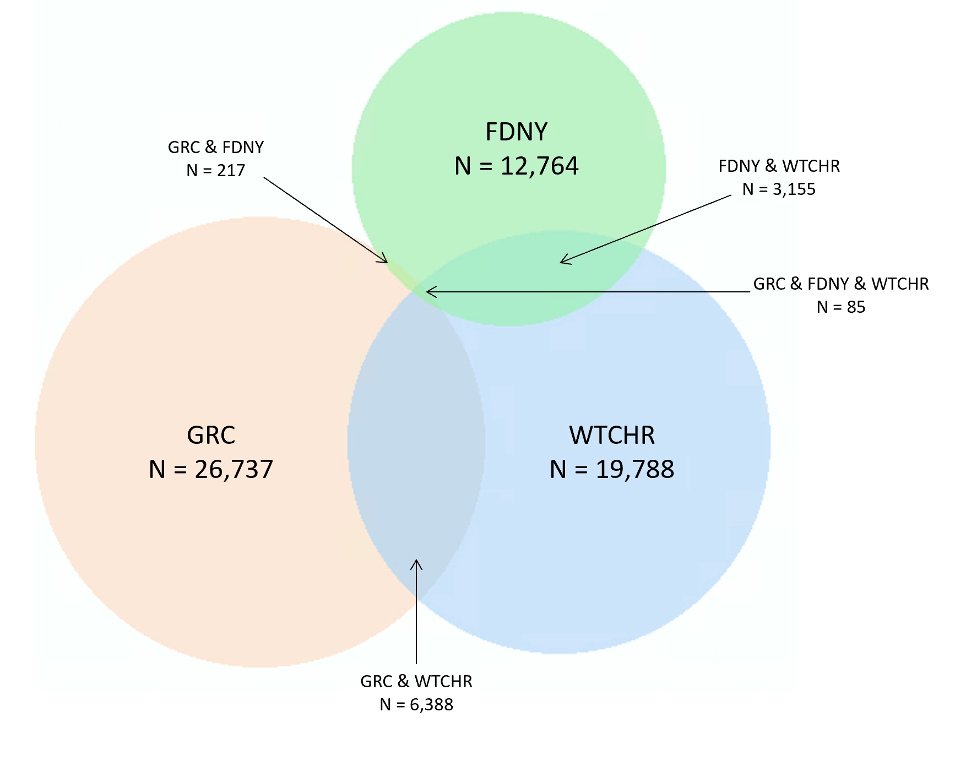
WTC Responder Cohort Overlap
Total: 69,134 WTC Responders: Fire, EMS, Police, Construction, etc
9,845 (14%) in more than one cohort

Slide 12
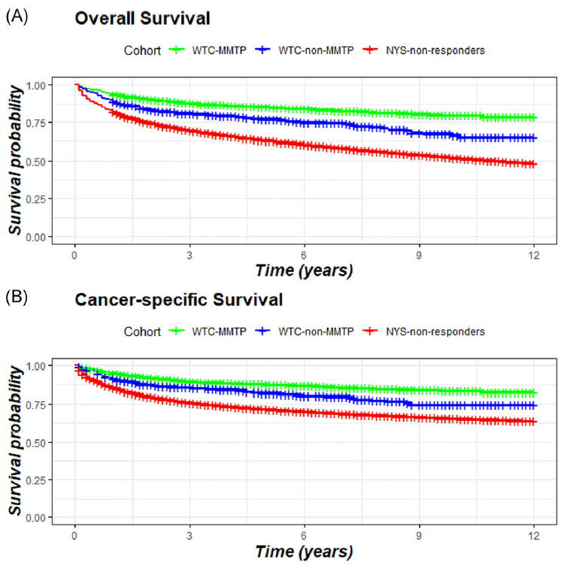
WTC Responder All Cause & Cancer Survival
WTC-MMTP vs NYS | HR 0.64 (95% CI 0.58-0.72)
WTC-non-MMTP vs NYS | HR 0.93 (95% CI 0.79-1.10)
WTC-MMTP vs NYS | HR 0.72 (95% CI 0.64-0.82)
WTC-non-MMTP vs NYS | HR 0.94 (95% CI 0.78-1.14)
WTC-MMTP = WTC Health Program
WTC-non-MMTP = WTC Health Registry
NYS = NYS State residents, same age, sex & same cancer
Ref: Goldfarb, Zeig-Owens et al AJIM 2021

Slide 13
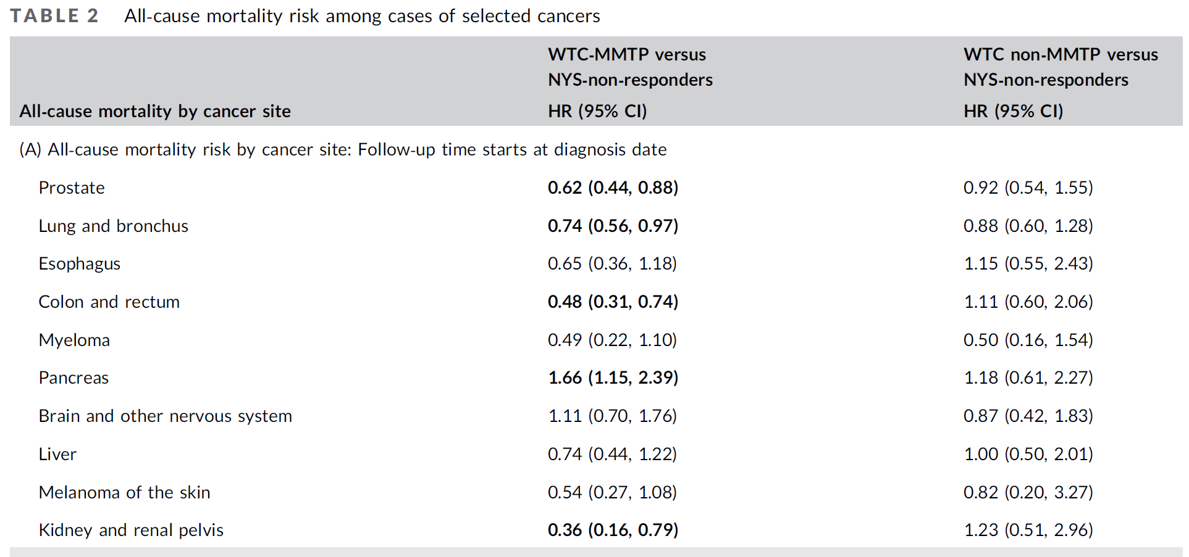
WTC Responders & Cancer Survival

Slide 14
WTC Responder Cancer Survival
WTC Health Program enrollees with
any cancer
WTC Health Program enrollees with
prostate cancer
WTC Health Program enrollees with
colon cancer
36% fewer deaths
38% fewer deaths
52% fewer deaths

Slide 15
Longer Survival in WTC Health Program Responders (FDNY & GRC) compared to NYS population with same cancer
All-cause Mortality by cancer site | WTC MMTP vs. NYS non-responders
 | HR (95%CI)
Prostate | 0.62 (0.44, 0.88)
Lung and bronchus | 0.74 (0.56, 0.97)
Esophagus | 0.65 (0.36, 1.18)
Colon and rectum | 0.48 (0.31, 0.74)
Myeloma | 0.49 (0.22, 1.10)
Pancreas | 1.66 (1.15, 2.39)
Brain and other nervous system | 1.11 (0.70, 1.76)
Liver | 0.74 (0.44, 1.22)
Melanoma of the skin | 0.54 (0.27, 1.08)
Kidney and renal pelvis | 0.36 (0.16, 0.79)
 | WTC MMTP (n=2,037) | NYS non-responders (n=574,075)
Deaths n (%) | 303 (14.9) | 224,040 (39.0)
Cancer deaths n (%) | 248 (12.2) | 158,645 (27.6)
Survival rate n (%)
1-year survival | 1,916 (94.1) | 474,895 (82.7)
3-year survival | 1,346 (88.3) | 326,959 (69.6)
5-year survival | 919 (86.1) | 228,933 (62.8)
Follow-up time starts at diagnosis date, males only, adjusted for age and date of diagnosis
Combining Three Cohorts of WTC Rescue/Recovery Workers for Assessing Cancer Incidence and Mortality.
Int. J. Environ. Res. Public Health. 2021
Cancer survival among WTC Rescue/Recovery Workers: a collaborative cohort study. Am J Ind Med. 2021

Slide 16
Summary:
  WTC & Career Firefighter Health Study: WTC-exposed vs Non-WTC exposed
    Confirms that Cancer rates are increased and that this is driven by specific types/sites
        Not just a healthy worker effect
    Cancer and All-cause Mortality is lower in FDNY WTC firefighters than other career firefighters
WTC Responder Combined Cohort Study:
    Confirms that Cancer rates are increased and that this is driven by specific cancer types/sites
    Cancer and All-cause Survival benefit from being in the WTC Health Program

Slide 17
Published Peer-Reviewed Medical Studies
Combining Three Cohorts of WTC Rescue/Recovery Workers for Assessing Cancer Incidence and Mortality. Int. J. Environ. Res. Public Health. 2021
Cancer survival among WTC Rescue/Recovery Workers: a collaborative cohort study. Am J Ind Med. 2021
Cancer incidence in WTC-exposed and non-exposed male firefighters, compared with the US adult male population: 2001-2016. Occup Environ Med. 2021 Oct;78(10):707-714
All-cause and cause-specific mortality in a cohort of WTC-exposed and non-WTC-exposed firefighters. Occup Environ Med. 2023 Mar 27:oemed-2022-108703. doi: 10.1136/oemed-2022-108703

