Slide 1
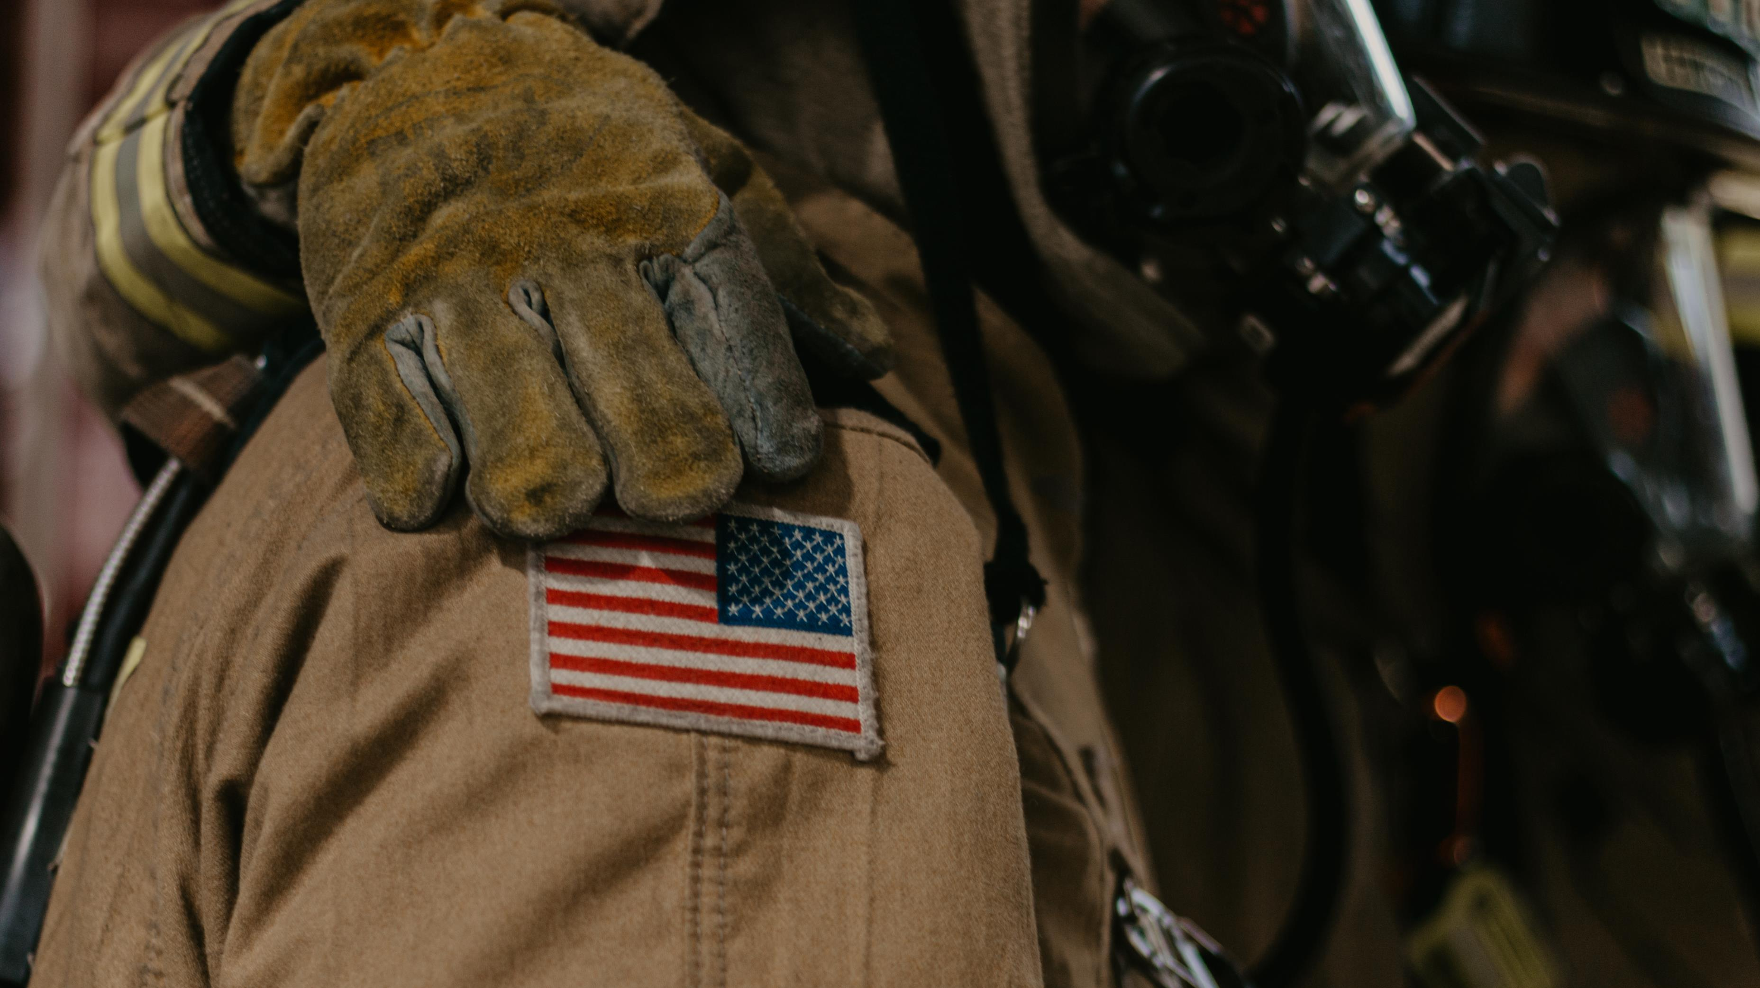


National Firefighter Registry for Cancer
First Responder Summit, July 27, 2023
Kenny Fent, PhD, CIH
National Firefighter Registry (NFR) for Cancer
National Institute for Occupational Safety and Health (NIOSH)

Slide 2
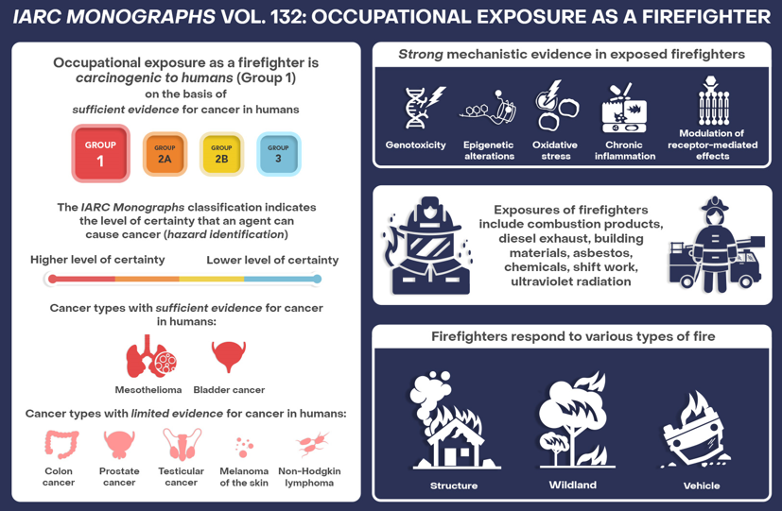
Cancer risk
https://www.iarc.who.int/infographics/iarc-monographs-evaluate-the-carcinogenicity-of-occupational-exposure-as-a-firefighter/
Notes:
IARC (the International Agency for Research on Cancer) recently classified firefighting as a Group 1 known carcinogen, based on sufficient evidence of mesothelioma and bladder cancer. The working group also found limited evidence of 5 other cancers and strong evidence of 5 key characteristics of carcinogens among exposed firefighters. These findings coupled with the fact that firefighters are exposed to numerous chemical carcinogens, shift work, and UV radiation, strengthens the evidence of the relationship between firefighting and cancer risks, at least for some types of cancer.

Slide 3
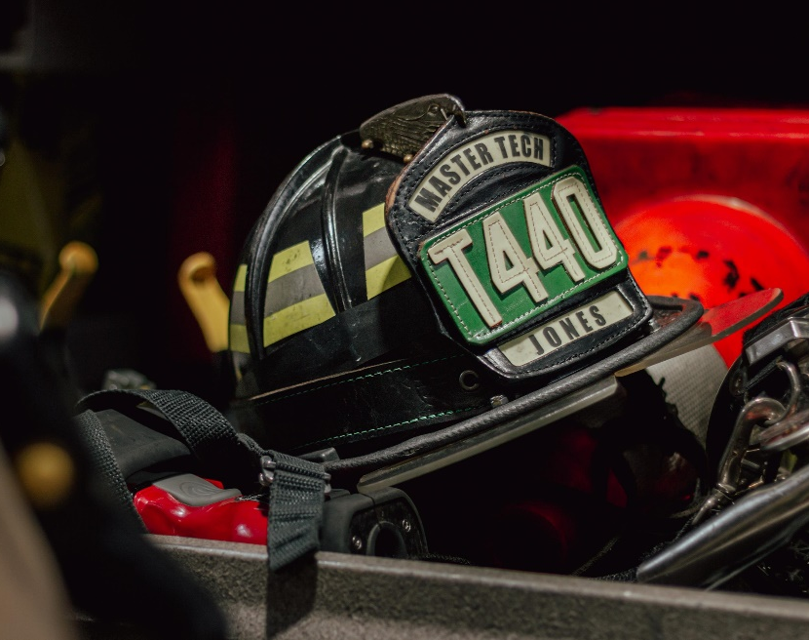
Knowledge gaps
What is the cancer risk for volunteer firefighters?
What is the cancer risk for the sub-specialties of the
fire service?
How does the cancer risk vary for demographic groups?
How does firefighters’ cancer risk vary regionally?
How prevalent are rare forms of cancer among firefighters?
How does the cancer risk change with increasing exposures, including from major events?
What other occupational and non-occupational risk factors contribute to cancer risk among firefighters?
Are there other chronic illnesses that are elevated in firefighters?
Notes:
The IARC evaluation is certainly an important product of all the research that has been done over the years, but there are still several knowledge gaps that exist
These are questions are difficult to answer unless you have large and diverse cohort that can be followed over a long period.

Slide 4
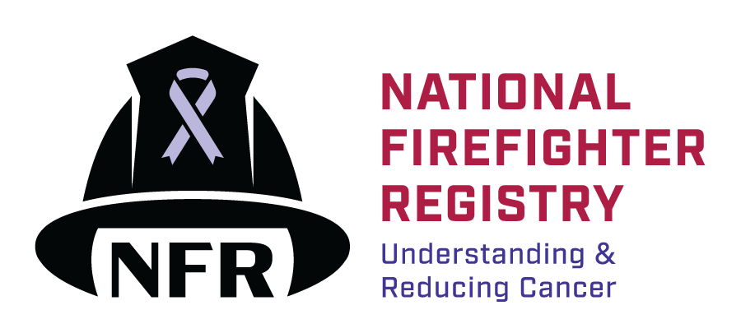
National Firefighter Registry (NFR) for Cancer
Mission: To generate detailed knowledge about cancer in the fire service through a voluntary registry that reflects our nation’s diverse firefighters.
Vision: To equip the fire service and public health communities with the knowledge they need to reduce cancer in firefighters.
Specific aims:
  Collect self-reported information on workplace & personal characteristics through web portal
  Obtain records from fire departments or agencies to track trends and patterns of exposure
  Link with health information databases including population-based cancer registries and the National Death Index to detect cancers and deaths
Notes:
That’s where the National Firefighter Registry for Cancer comes into play. The NFR was created through an act of legislation: the Firefighter Cancer Registry Act.
Our Mission is to…
Our Vision is to…
Our specific aims are to…

Slide 5

The missing piece
Cancer
Occupational exposures
Firefighter
In the United States:
Cancer reportable in all 50 states
States do not collect detailed information about occupation
NFR allows someone to register as a firefighter and provide details about their work history and other factors
Makes it possible to study the relationship between “firefighting” and “cancer”
Notes:
It’s important to understand how cancer is currently monitored in the United States. Cancer is a reportable illness in all 50 states. However, states do not collect detailed information about occupation. In fact, often times, no occupational information is attached to a cancer diagnosis. So, if someone is diagnosed with cancer, researchers may not even know they are a firefighter, and they definitely won’t know how long they were a firefighter or what they did as a firefighter. The NFR for Cancer is way for people to tell us they are a firefighter and provide details about their work history and other factors. So, that if they develop cancer (or already have cancer), we can capture the cancer information from the state cancer registries and combine it with the occupational information in the NFR. That then provides a very powerful dataset to study the relationship between firefighting and cancer.
In this figure, you have occupational exposures on the left (all those fire response over a career) and you have cancer outcomes on the right. And the missing puzzle piece is the firefighter. We need more information about the individual firefighter. And that’s what the NFR is doing.

Slide 6
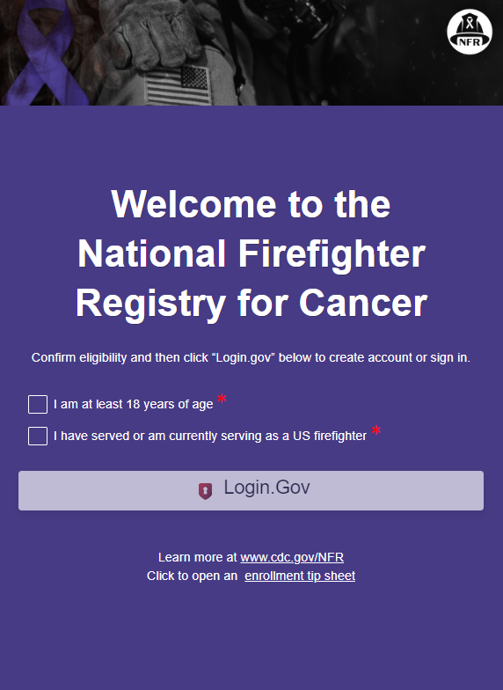
Enrolling
Visit web portal NFR.cdc.gov
Confirm eligibility and click Login.gov
Create account
Read and sign consent form
Fill out user profile
Complete the questionnaire
  Demographics, work history, health history, lifestyle
30 – 45 minutes
Launched in April 2023
>6400 firefighters have signed up so far!
Notes:
The way firefighters enroll is straight forward…
The only eligibility requirement is that you are 18 years of age or older and have served as a firefighter.
The questionnaire is the longest part of this process. This is because it’s important that we capture details about a firefighters’ work if we are to understand what it is about firefighting that is associated with increasing cancer risk.
The entire process takes about 30 minutes, but could take longer for more veteran firefighters, mainly because they have more occupational history to report.
The NFR launched in April 2023 and so far we have >6400 firefighters who have signed up
That’s a good start, but our ultimate goal is to enroll 200,000 firefighters, so we have a lot of work left to do. But we are committed to doing everything in our power to ensure success.

Slide 7
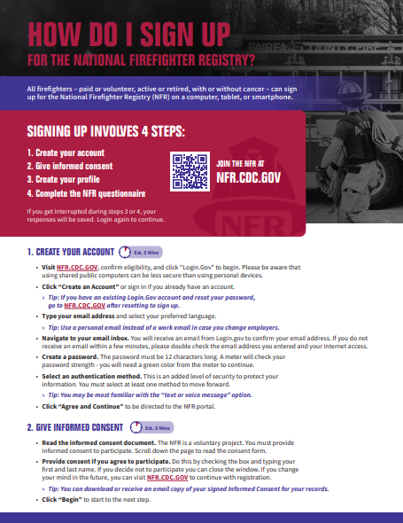
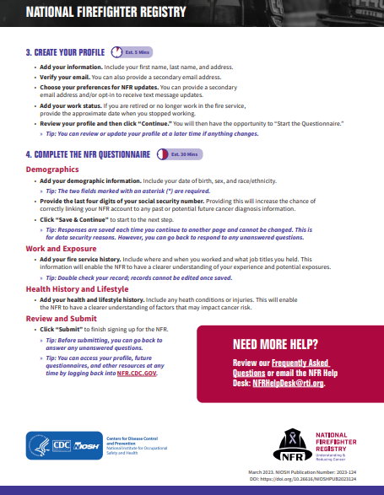
Enrollment Tip Sheet
Notes:
On our web portal, we have this really great resource that provides step by step tips on how to register. This can be referenced before and during the enrollment process.

Slide 8
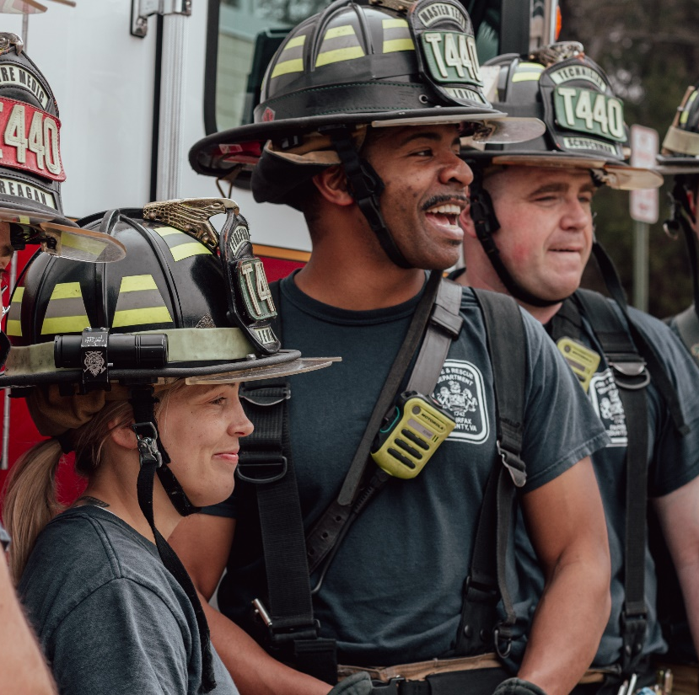
Who’s eligible?
ALL firefighters!
  Active and retired
  Career and volunteer
  Structural, wildland, or other specialties
  Those with or without cancer
Notes:
You may wonder who is eligible to participate in the NFR. The NFR is open to all firefighters…

Slide 9
Data security
Logging into web portal requires multi-factor authentication
Email, password, and another form of authentication (e.g., text message passcode)
Data uploaded to an encrypted database each time the firefighter clicks “save and continue” or logs out
Logging out saves progress
Privacy protected by an Assurance of Confidentiality
Identifiable information will not be shared outside of NIOSH
Notes:
Data security is a top priority. We built the enrollment system to be extremely secure. Logging into the web portal requires multi-factor authentication – which most people are familiar with these days – where you enter email, password, and another form of authentication. Data in the web portal is uploaded to an encrypted database each time the firefighter clicks “save and continue” or logs out. Speaking of logging out. If you log out and log back in later, you will be taken to where you left off. In terms of privacy, we have an Assurance of Confidentiality, which protects firefighters’ identifiable information from release.

Slide 10
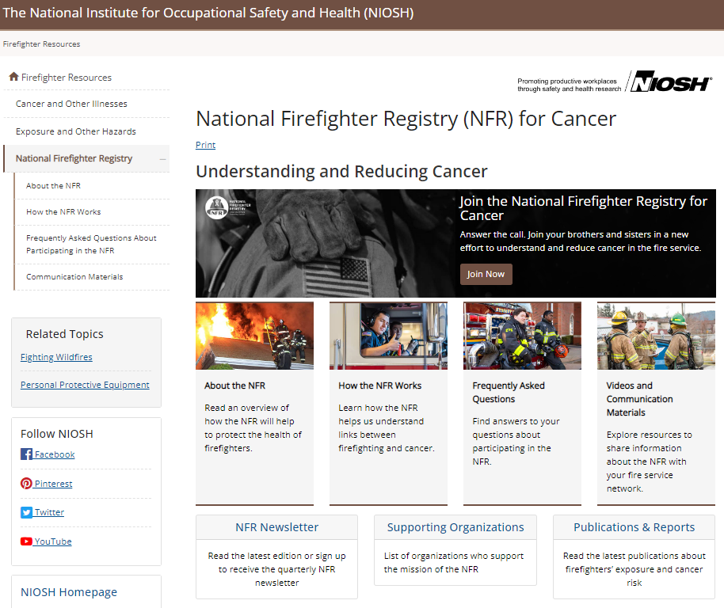
www.cdc.gov/NFR
Join now – link to web portal
Topic pages: About the NFR, How the NFR works, and FAQs
Videos and communication materials
NFR newsletter
Publications
Supporting organizations
Notes:
If you want more information, our website is regularly updated and includes various topics pages, FAQs, videos, communication materials, and other resources.

Slide 11
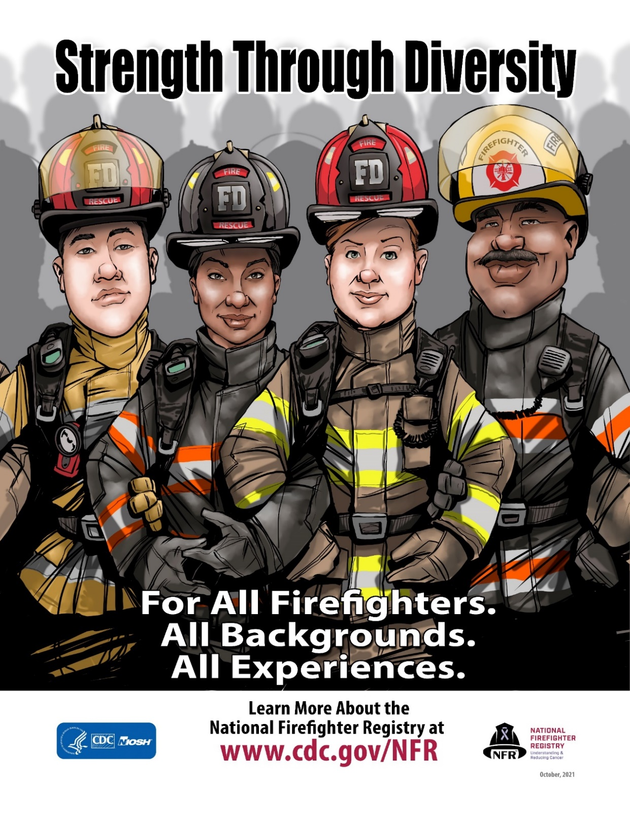
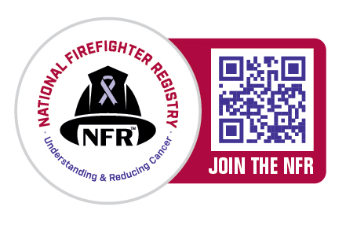
Thank you!
The findings and conclusions in this presentation are those of the authors and do not necessarily represent the official position of the Centers for Disease Control and Prevention, National Institute for Occupational Safety and Health.
Notes:
For the NFR to be successful, we need broad participation across the fire service. The more firefighters who enroll, the more we can learn about their cancer risk and specific factors contributing to that risk. If you know firefighters, please let them know about this important program.

