Slide 1
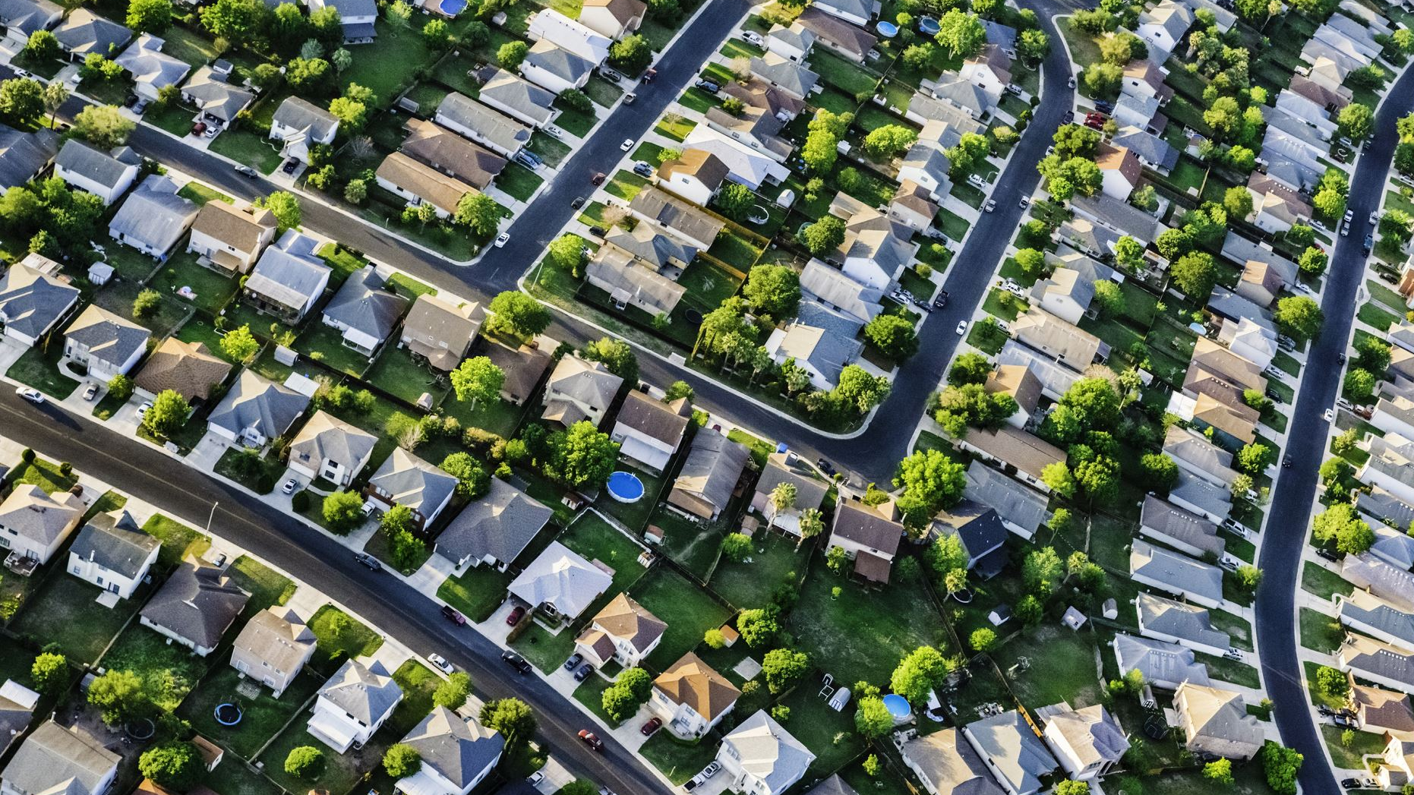
How do we Support and MobilizE the AANHPI community in Western NY?
Christina Heyon Lee, EdD
Community member, VP, Brighton CSD and Director, Global Education and International Services, MCC (SUNY)

Slide 2
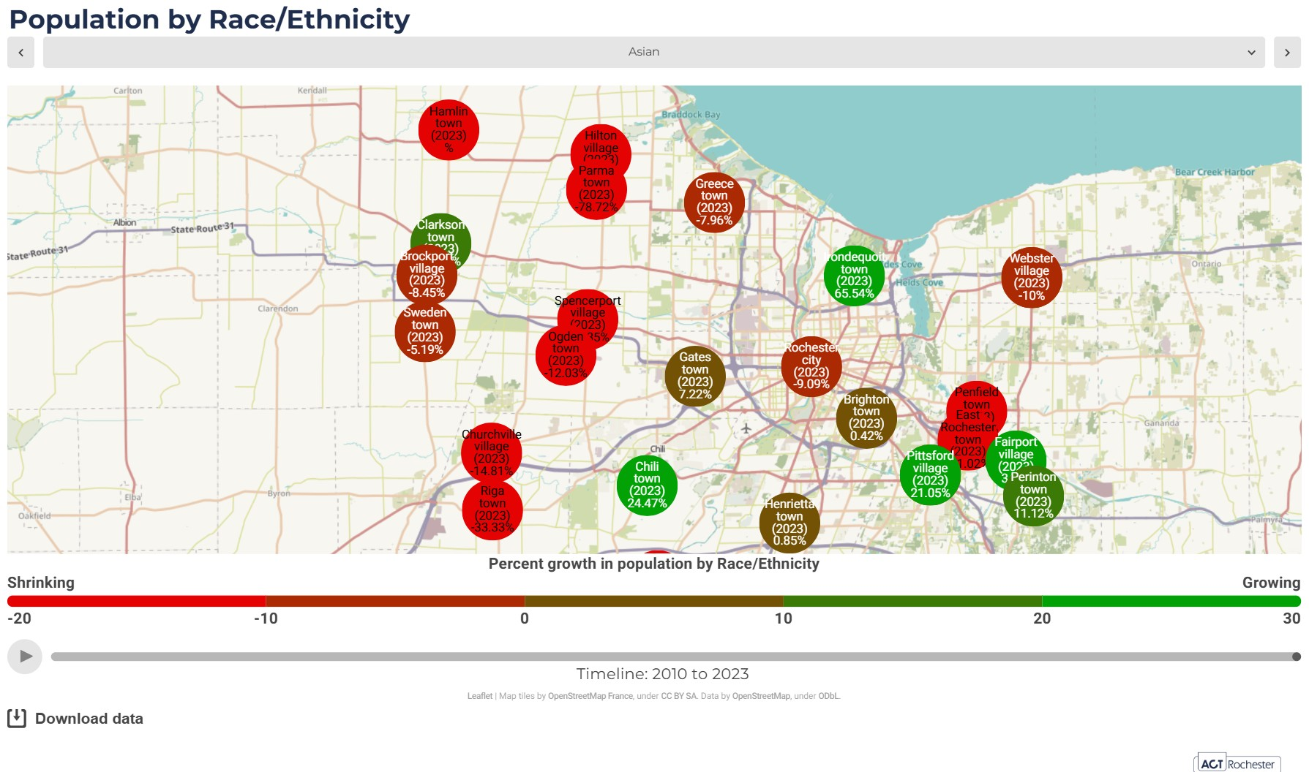
Monroe County Population Growth by Race

Slide 3
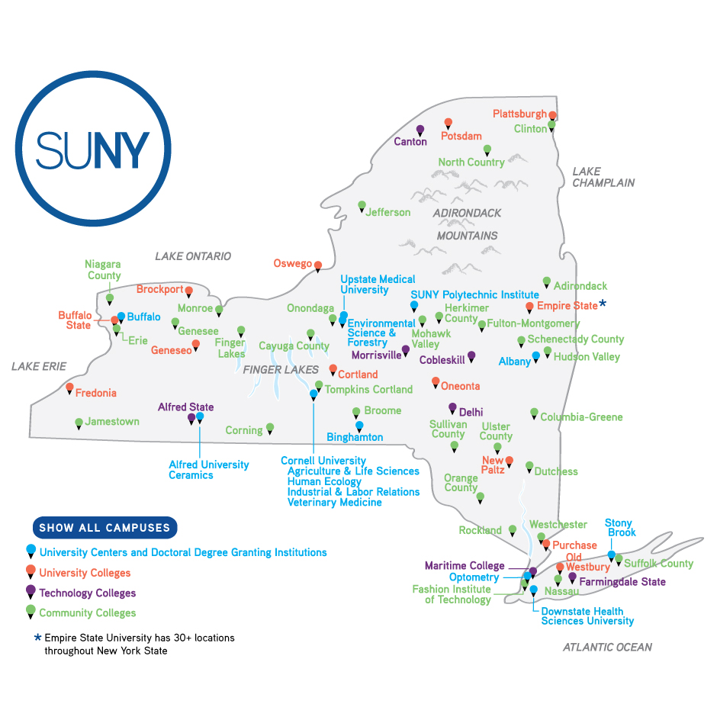
State University of NEW York
Leadership Institutes:
AANHPI, HLI, BLI

Slide 4
New York State School Board Association (NYSSBA)
Serves 5000 school board members across the state in 678 districts
We identified 67 possible AAPI BOE members in July 2025
Engaged with 20 members
Encouraging Asian American community members to consider school board service
Identifying advocacy efforts

Slide 5
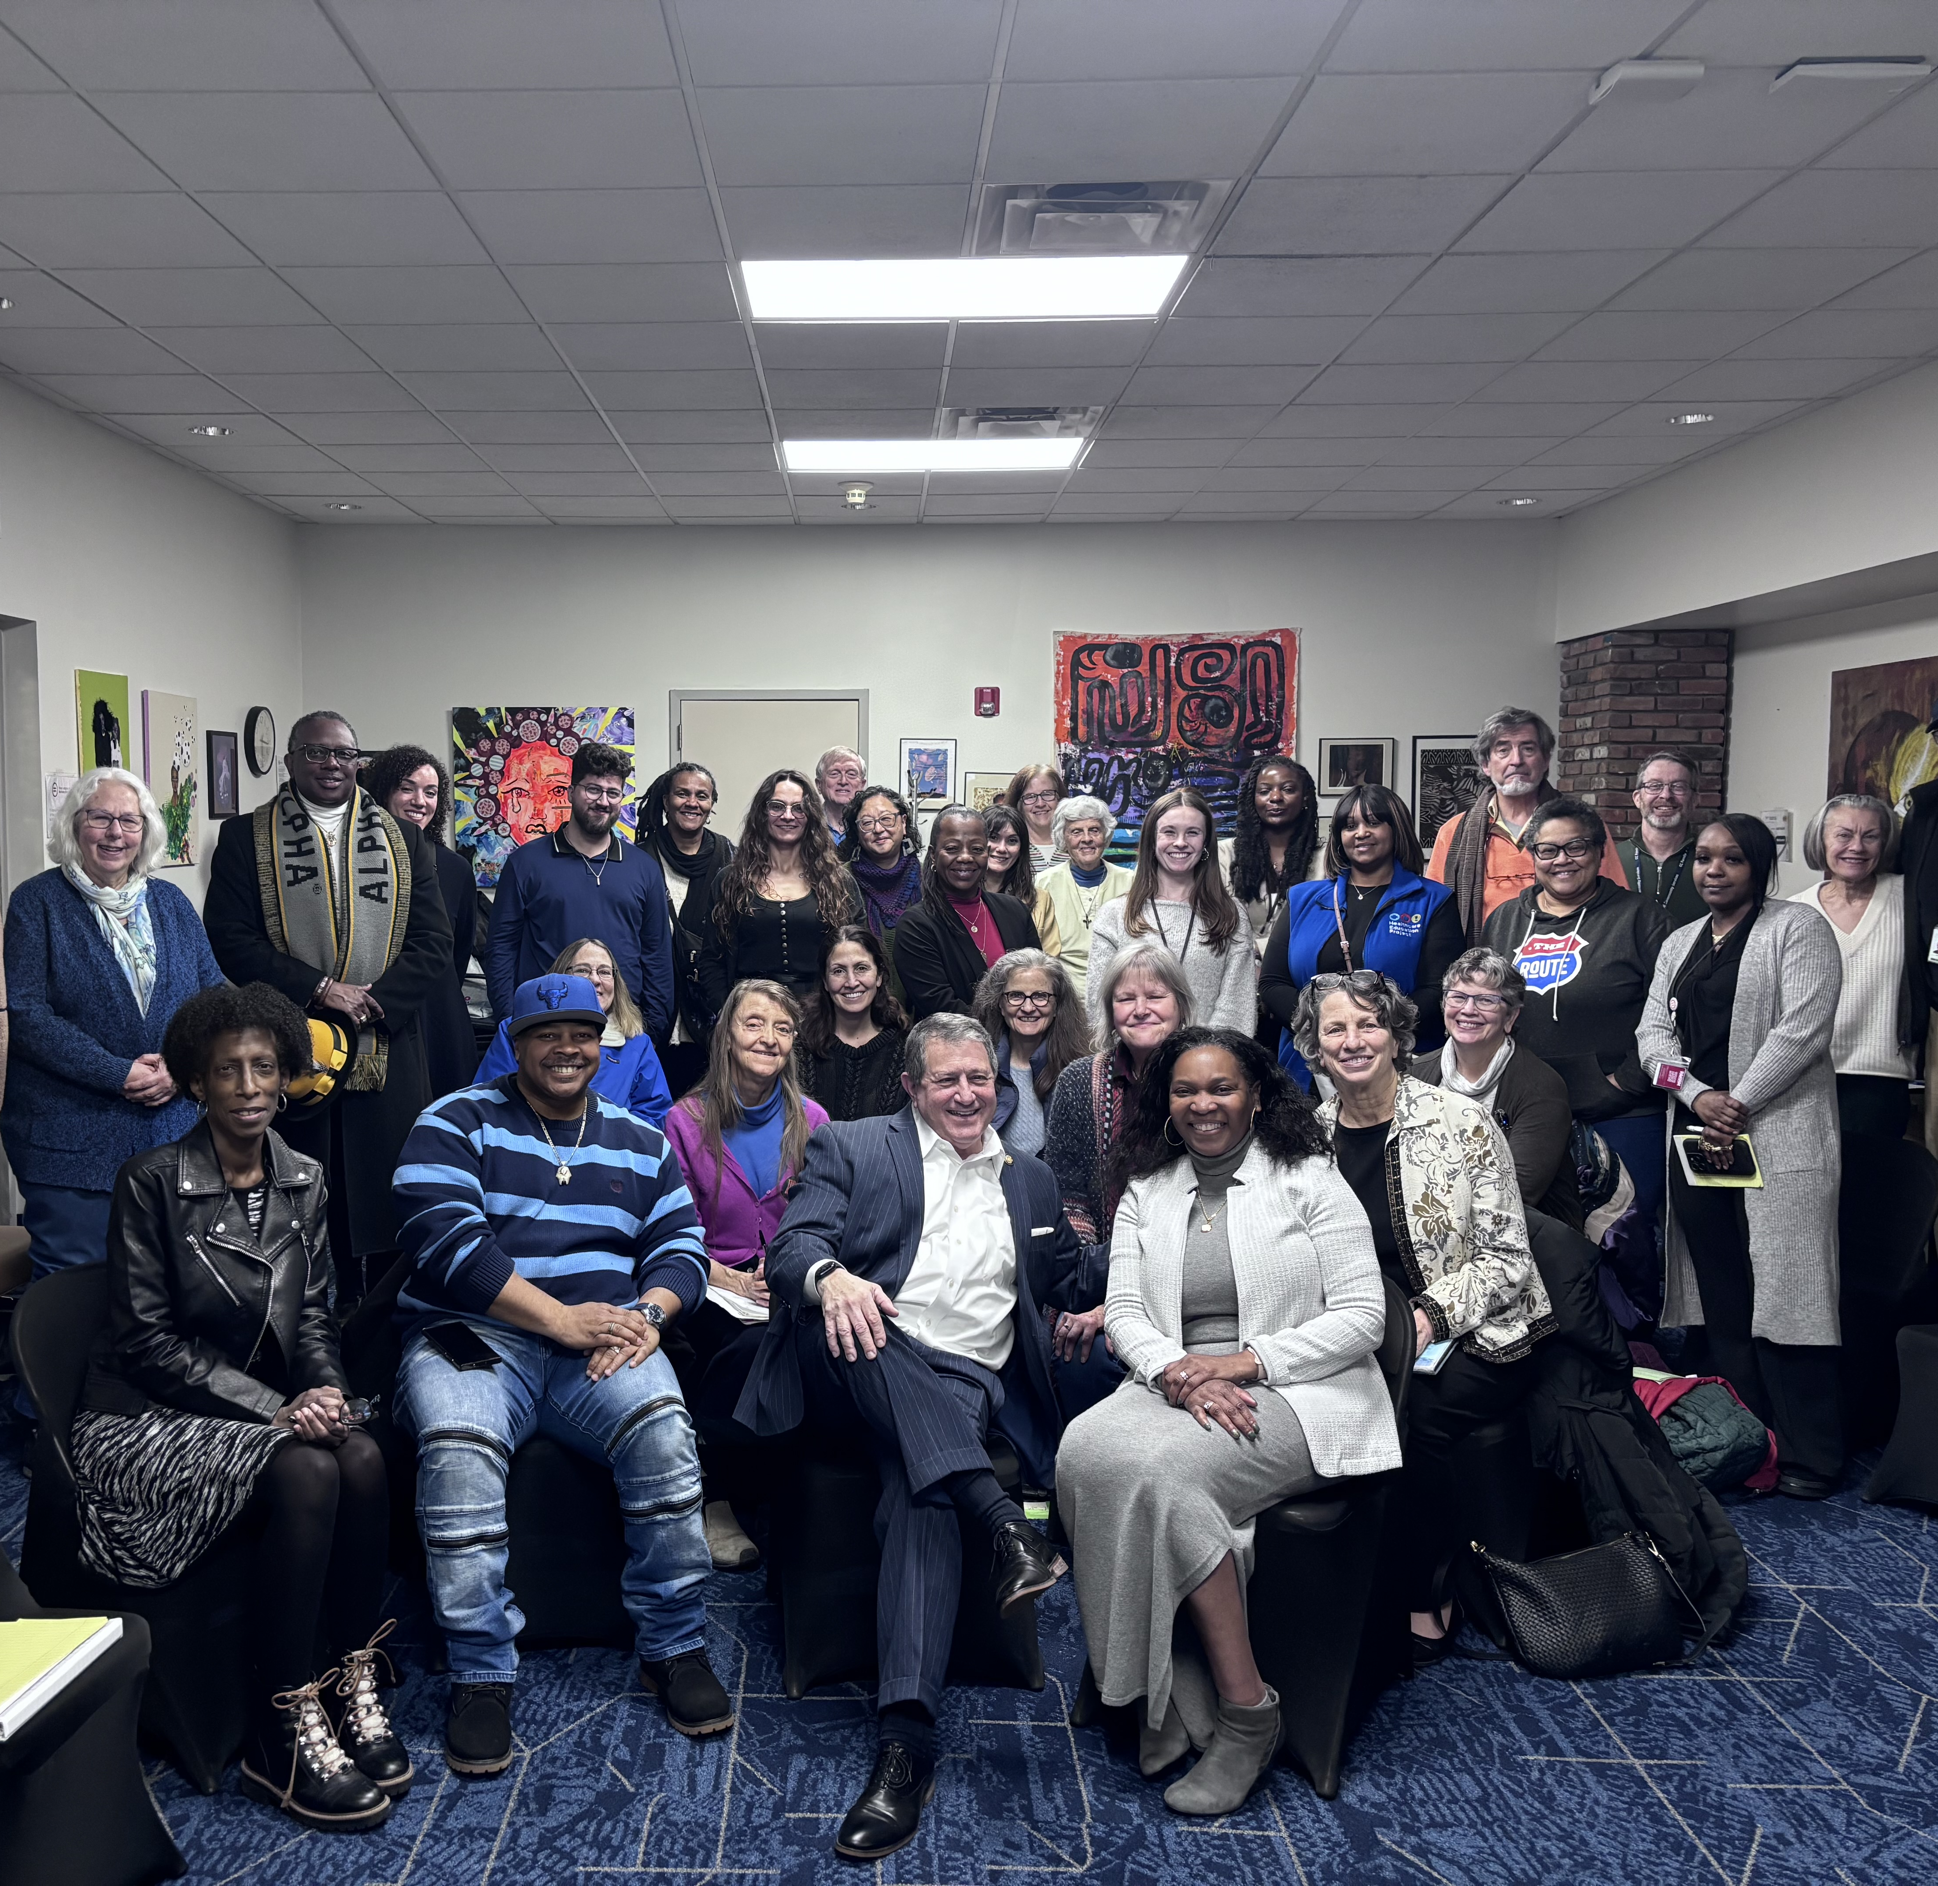
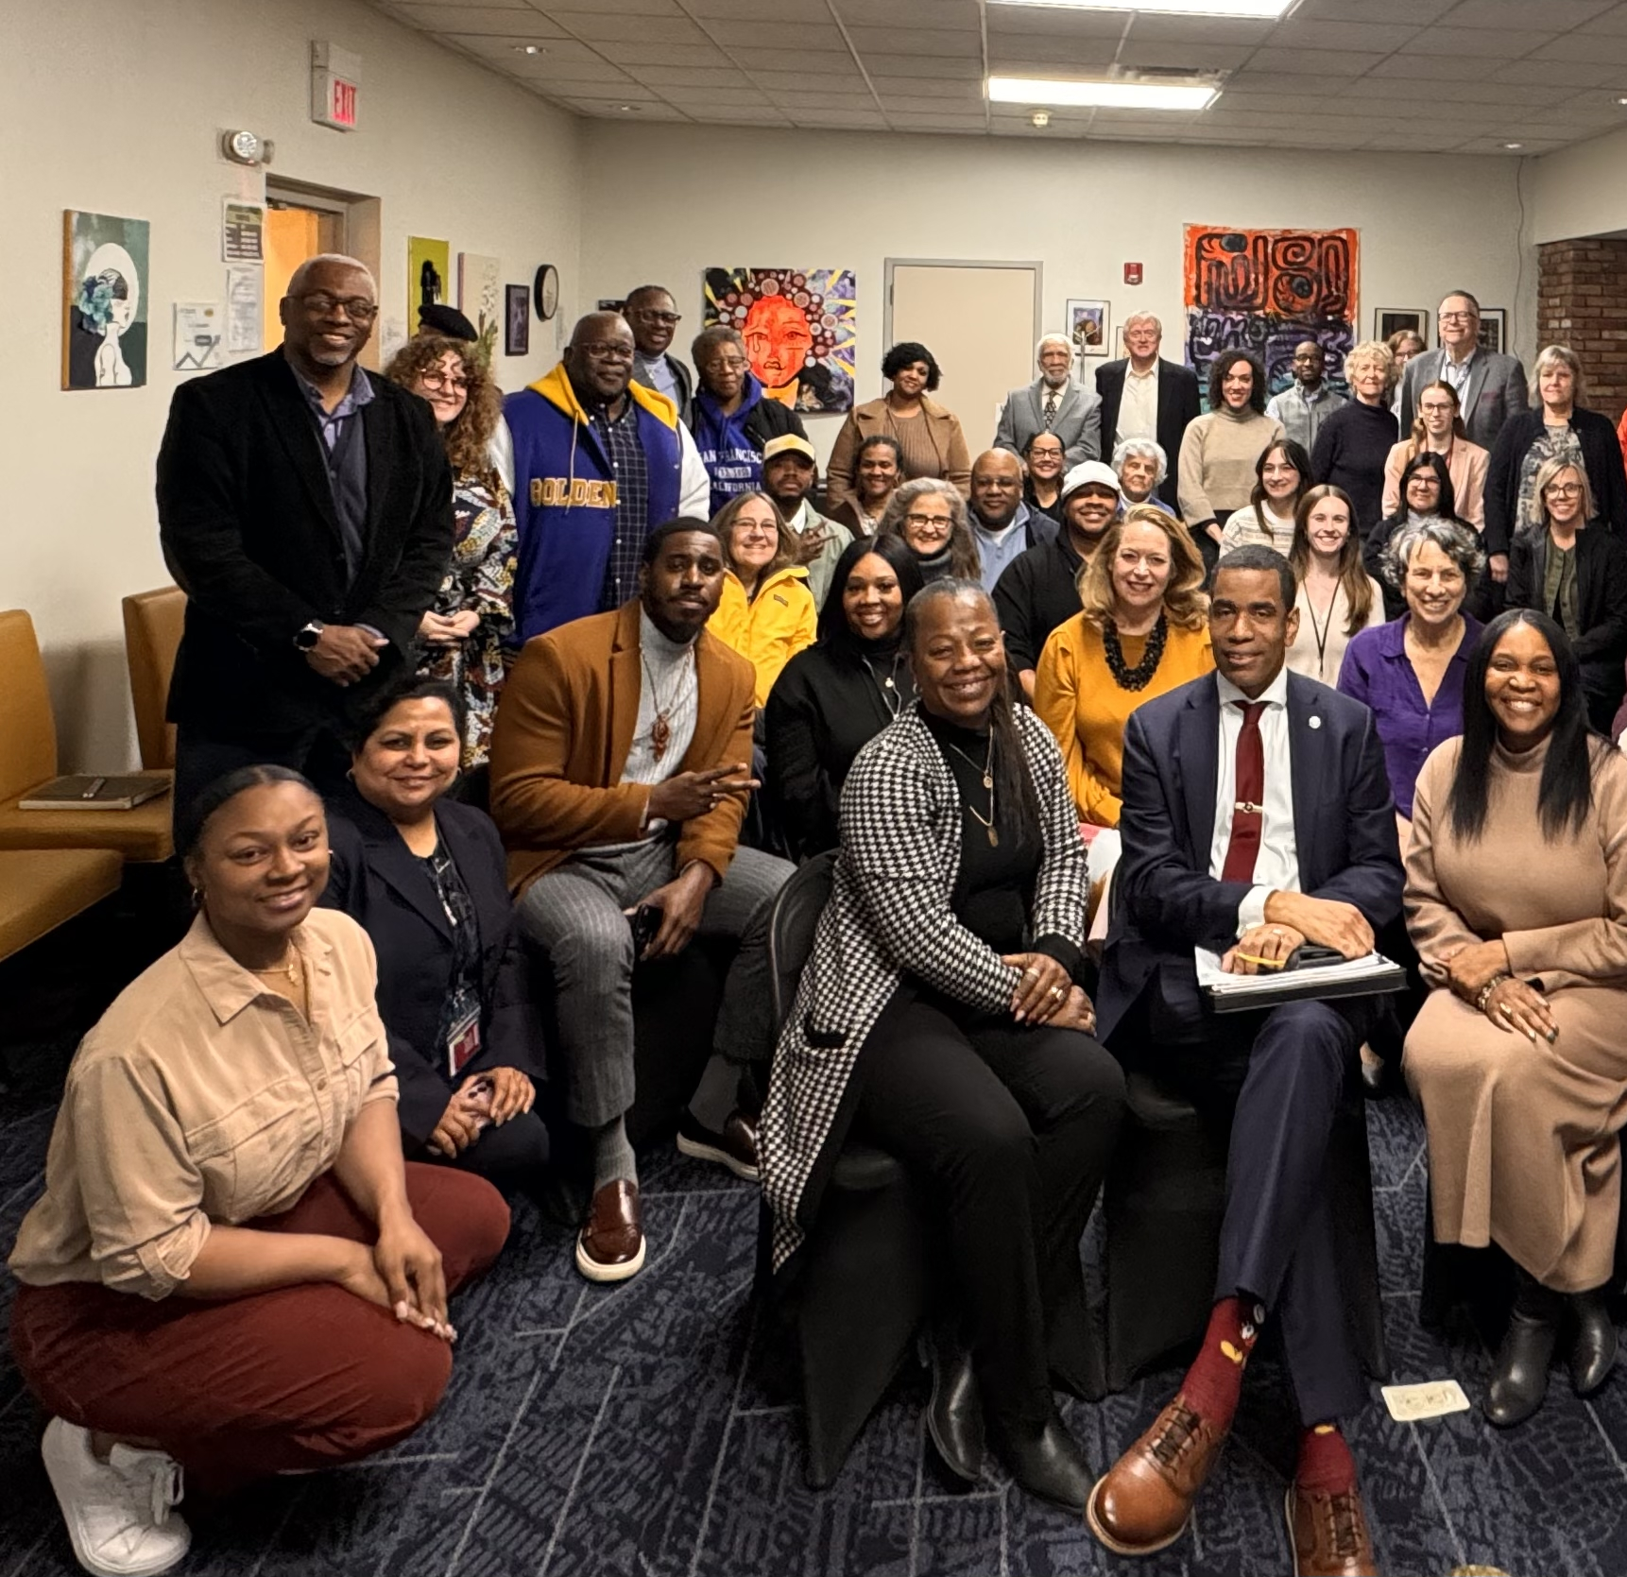
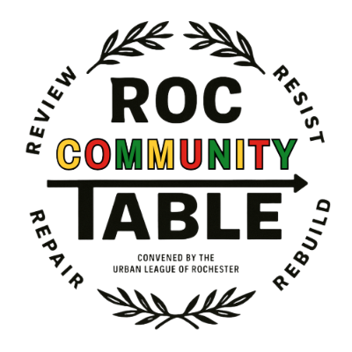
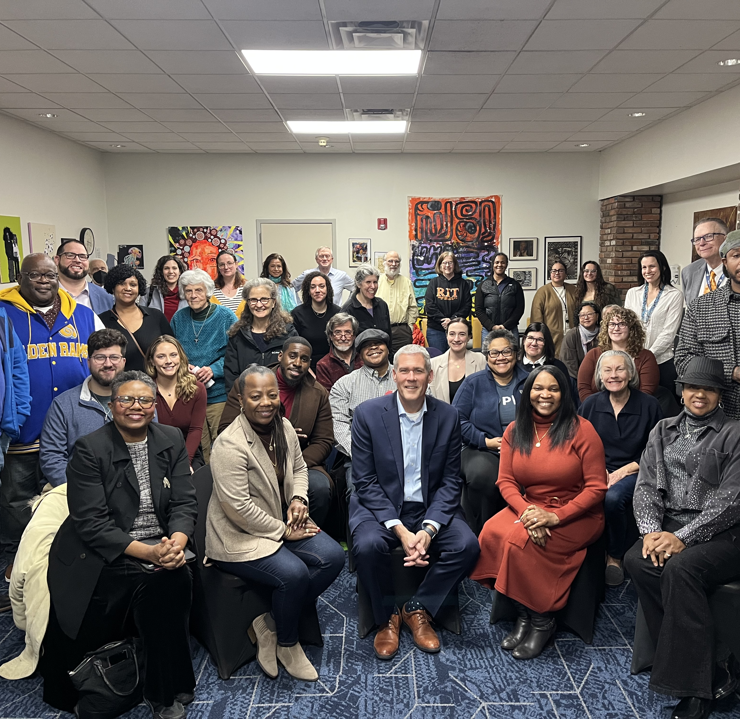
Urban League: Roc Community Table

Slide 6
Challenges and solutions
Conduct a needs assessment across Western NY
  Where does the community turn to in times of crisis?
Geographically challenging (transportation)
  Indian Cultural Center (Macedon, NY)
  Asian American Center (in progress)
  Churches and temples
  Refugee resettlement organizations
  Cultural and ethnic organizations
Reaching multilingual communities
Lack of social support organizations outreach to AANHPI communities
Engaging across generations and ethnic and racial groups

