Slide 1
Empire State Development
Division of Small Business & Technology Development

Slide 2
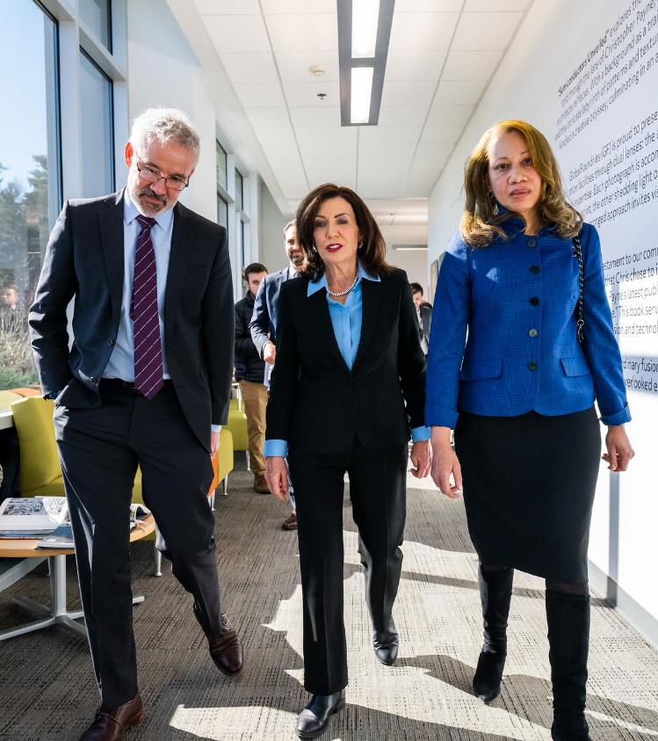
ESD's Mission
Empire State Development’s (“ESD”) mission is to:
Promote a vigorous, inclusive and growing state economy;
Encourage business investment and job creation;
Support diverse, local economies across New York State.
Through the efficient use of loans, grants, tax credits, real estate development, marketing, and other forms of assistance.

Slide 3
New York State’s Chief Economic Development Agency
Empire State Development
Capital Access
Entrepreneur Development
NY Ventures
NYSTAR
Life Sciences Initiative
Regional Economic Development Councils
GO-SEMI
ConnectALL
Global NY
(Export Support)
Film, Arts & New Media
Strategic Workforce Development
Minority & Women’s Business Development
Division of Tourism
(I LOVE NY)
Real Estate
Strategic Business Development
= Division of Small Business & Technology Development

Slide 4

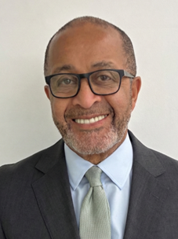




Small Business & Technology Development
Promoting growth by helping small businesses with access to capital, innovation infrastructure, venture funding, technical assistance, and other support services.
Elizabeth Lusskin
Executive Vice President
Small Business &
Tech. Development
Ray Salaberrios
Senior Vice President
Capital Access
Earl Thomason
Vice President
Entrepreneur
Development
Jennifer Tegan
Managing Director
NY Ventures
Ben Verschueren
Executive Director
NYSTAR
Adam Volini
Executive Director/
Vice President
Life Sciences

Slide 5
Supporting the Entire Business Lifecycle
Planning
Startup
Ramp Up
Scale
Maturity
SBTD’s Strategic Programmatic Support
Training & Technical Assistance | Innovation Support | Access to Capital | Ecosystem Connections | Commercialization

Slide 6
Capital Access
Capital Access helps New York’s small businesses access affordable loans and flexible financing so that they can grow and achieve success.
$1.1 Billion
Authorized for reduced interest rate loans (2025)
10,000+
Businesses and unbanked individuals received Technical Assistance (2024)
90% of Businesses
Receiving funding are historically disadvantaged

Slide 7
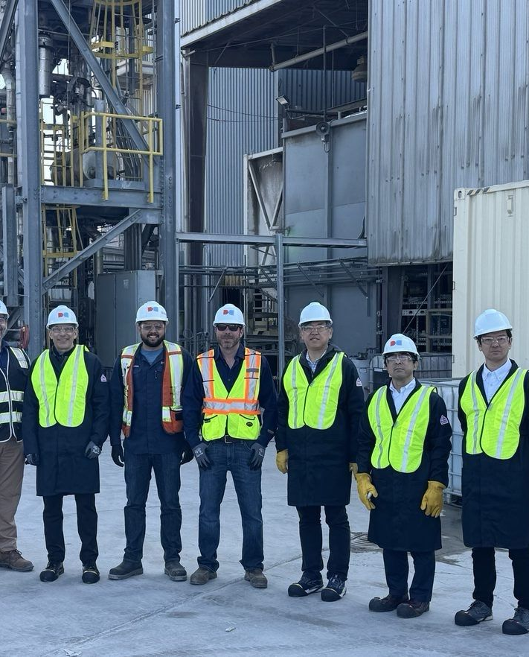
Helping NY Businesses Access Capital
Supporting small businesses, contractors and manufacturers across New York with:
  Free technical assistance
  Affordable, flexible loans
      ($10,000 - $2,000,000)
  Expanded community lending
      Partnering with CDFIs and community lenders

Slide 8
Entrepreneur Development
Entrepreneur Development empowers entrepreneurs to grow their businesses, driving inclusive economic growth and creating a thriving New York State where every entrepreneur can reach their full potential.
5,069 Entrepreneurs
Enrolled in training (2025)
218 New Businesses
Created and 324 Retained (2025)
$52.9 Million
Increase in Sales of program participants (2025)

Slide 9
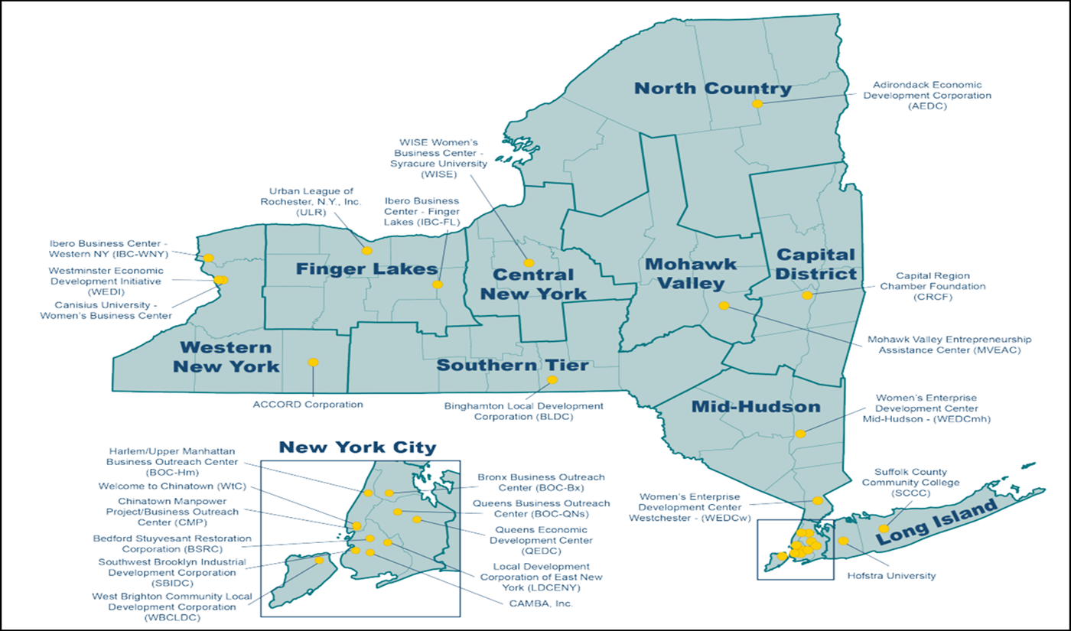
Helping Entrepreneurs Launch and Grow
Empowering NY’s next generation of small businesses through:
26 Entrepreneurship Assistance Centers
Comprehensive business planning and launch training
New York State Contract Reporter

Slide 10
NY Ventures
New York Ventures fuels innovation and startup growth in strategic sectors across all of NYS by investing venture capital that drives long-term economic progress.
$320 Million
Public funding for venture investments
145+ Companies
and 11 Funds invested in
9x Private Investment
Every $1 invested unlocked $9 in additional private capital

Slide 11
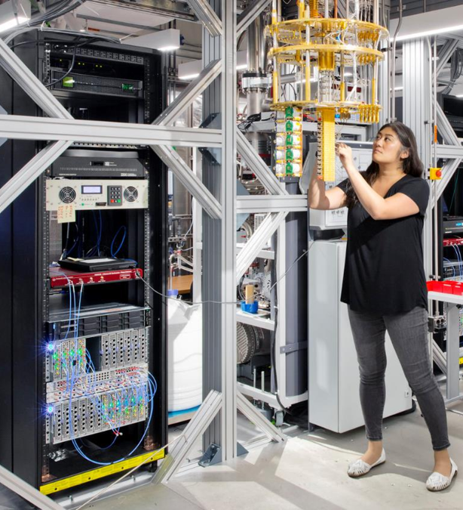
Funding Innovation, Multiplying Impact
Investing in high growth companies through:
Direct equity investments
  Pre-Seed to Series B
  $50,000 - $3,000,000
Indirect investments via emerging & regional fund managers
  $2,000,000 - $15,000,000
In
  Across key, strategic sectors
    Clean Energy/Climate Tech, Health Care/Life Sciences, Computational/AI, Advanced Manufacturing, Agricultural Systems, Social Impact

Slide 12
NYSTAR
The Division of Science, Technology & Innovation (NYSTAR) catalyzes New York’s innovation ecosystem by connecting academia and industry, accelerating breakthrough technologies, and making investments that leverage the state’s unique strengths to spark world-changing impact and drive resilient economic growth.
80+ Innovation Hubs
35 University Tech Centers
11 Manufacturing Centers
37 Incubators & Accelerators
$90+ Million
Annual investment in NYS innovation ecosystem
$2.8 Billion
Annual non-Job Economic Impact

Slide 13

Fostering Innovation, Fueling Growth
Catalyzing and commercializing breakthrough technologies through:
Strategic partnerships between industry and academia
Matching grants for federally funded research
Manufacturing centers that help small- and mid- sized manufacturers increase capacity and optimize operations

Slide 14
Life Sciences Initiative
New York State’s Life Sciences Initiative transforms breakthrough ideas into world-changing solutions by uniting cutting-edge research, next generation digital and physical infrastructure, and a diverse, highly skilled workforce to accelerate the path from discovery to impact.
$248+ Million
Committed to grantees and programs since 2017
43% More
Life Sciences Employers in NYS since 2017
$6.4 Billion Leveraged
Every $1 invested unlocked $16 in additional public and private capital

Slide 15
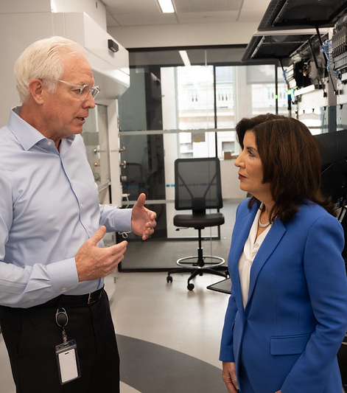
Building the Future of Life Sciences
Strengthening New York’s position as a global life sciences hub through:
Industry infrastructure investments
Support for translational research
Incentives for job creation
Notes:
Photo credit: Don Pollard/Office of Governor Kathy Hochul

Slide 16

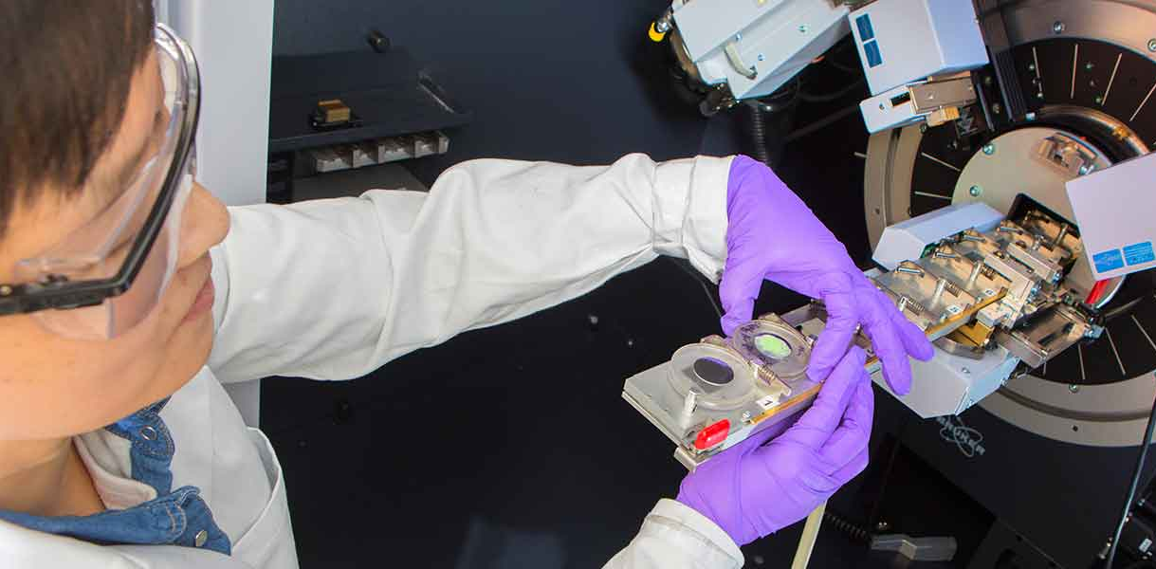
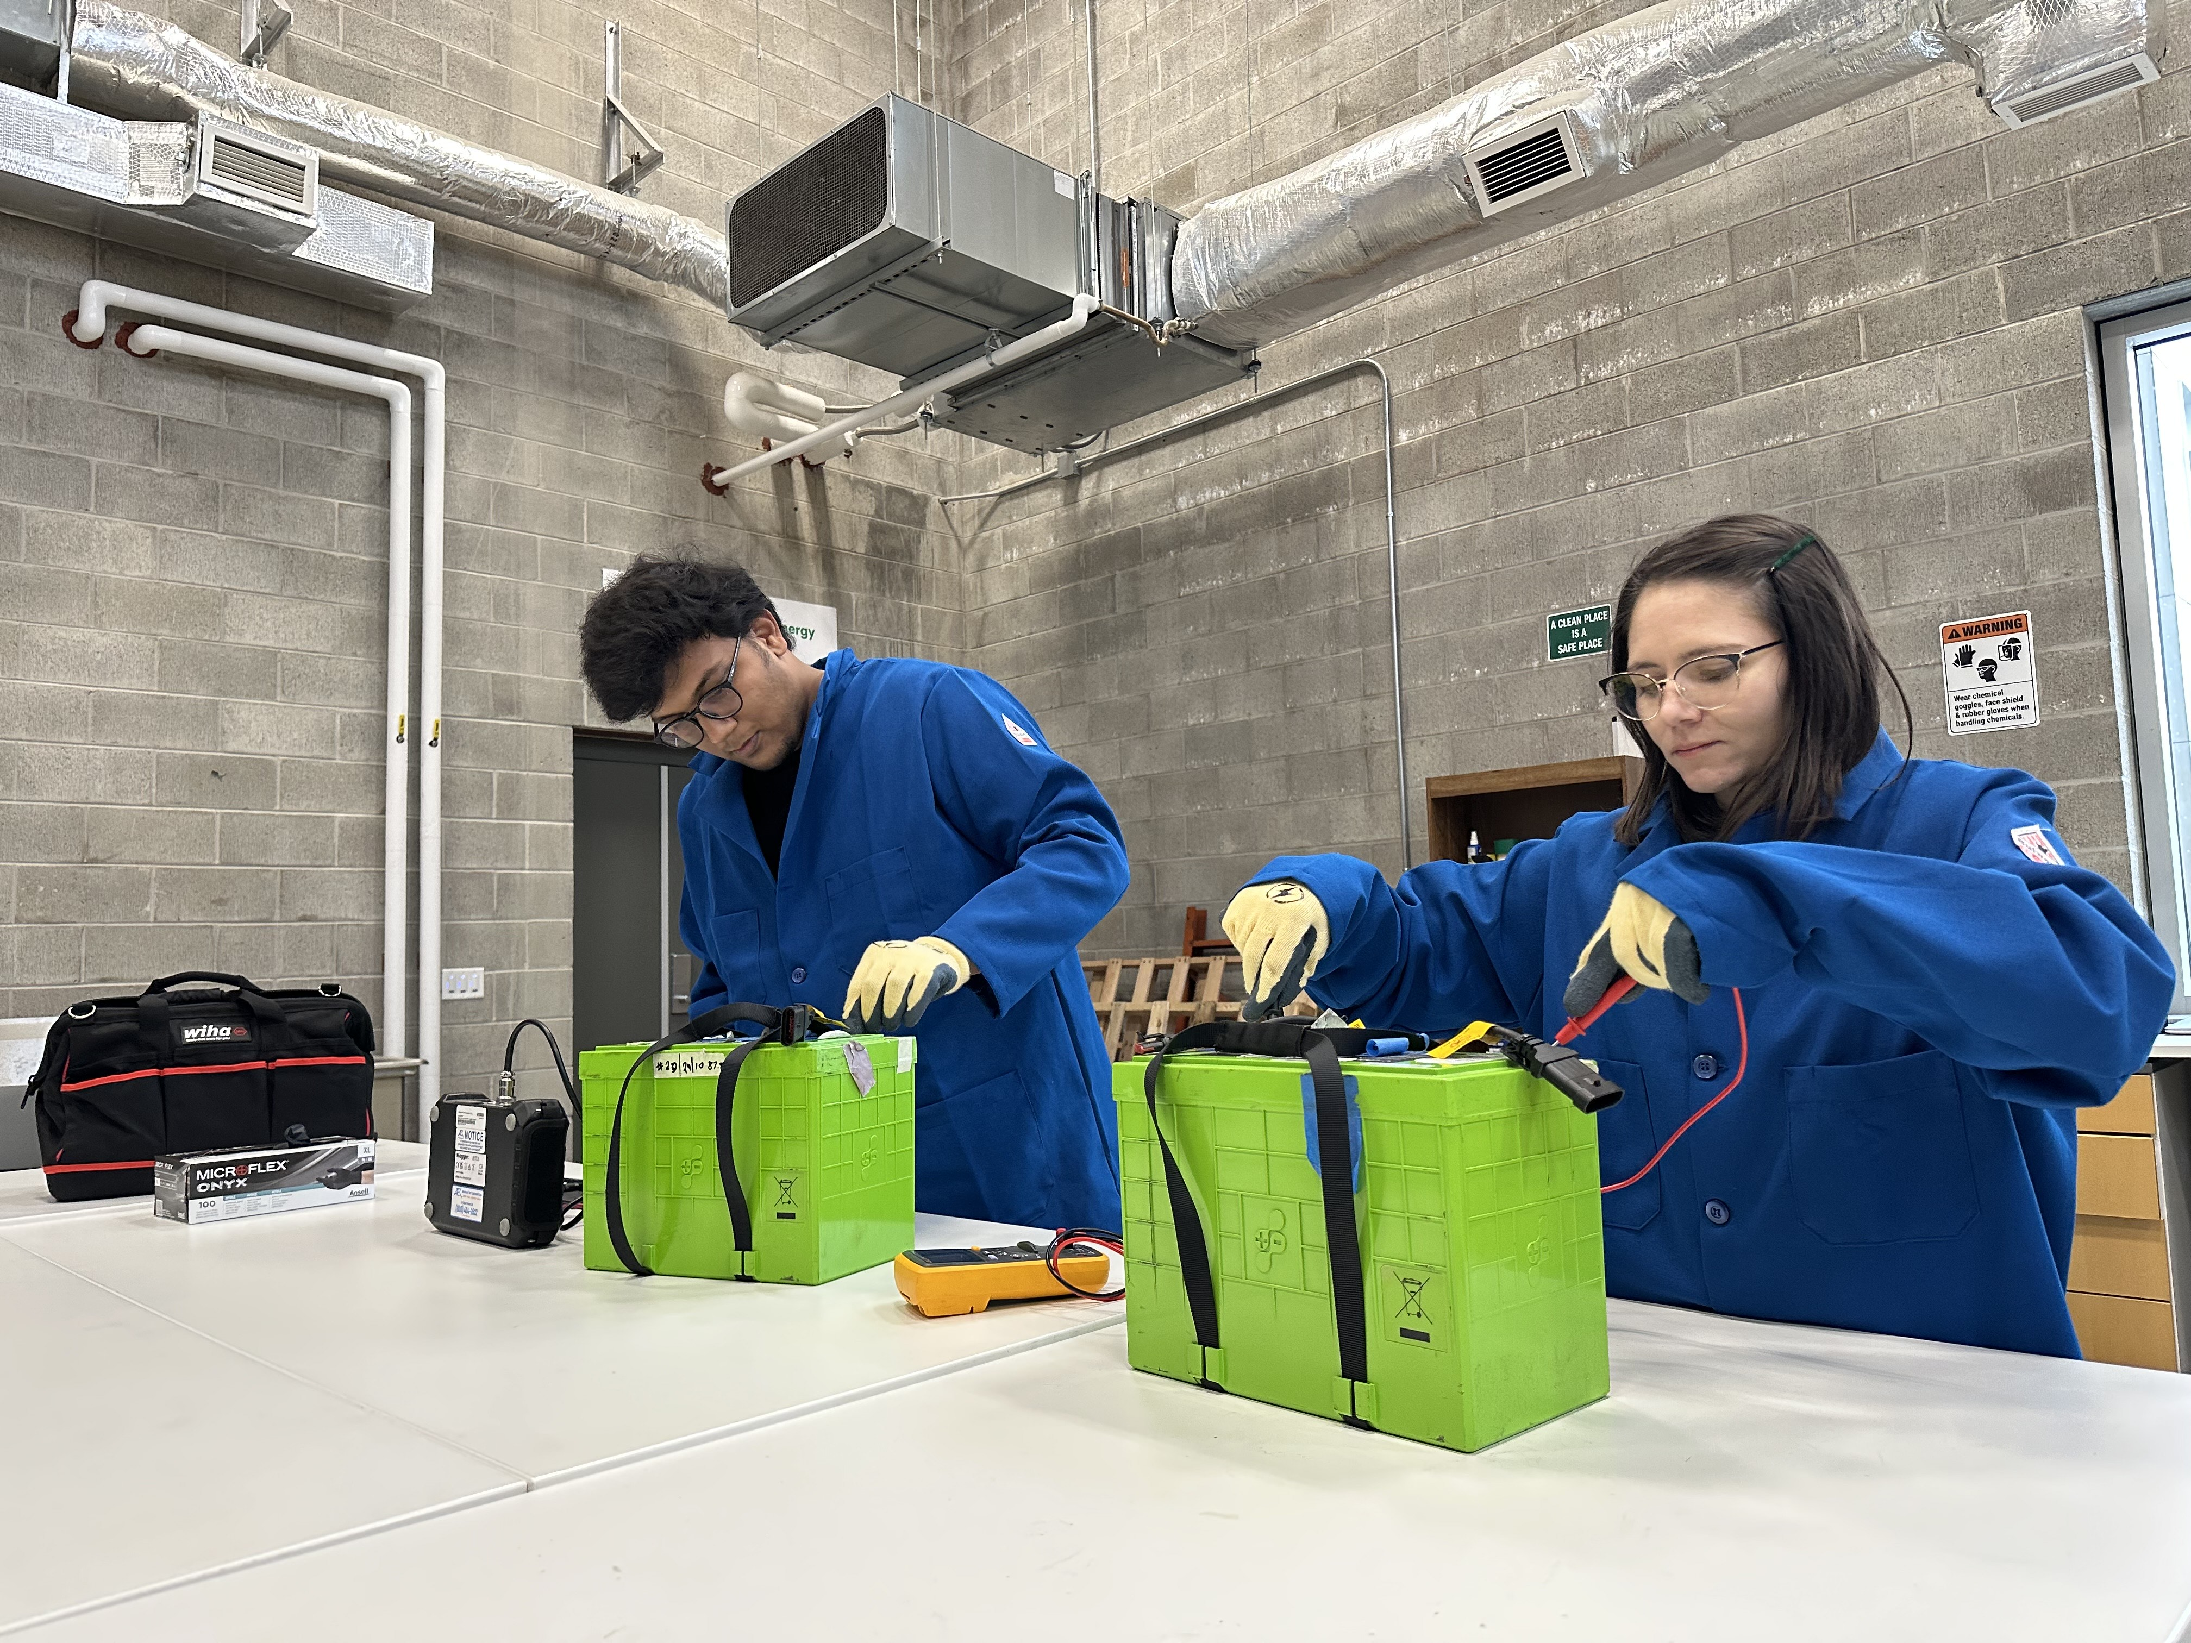
From barbershops to biotech, the best place to start, scale and sustain the businesses of today and tomorrow is New York State.

Slide 17
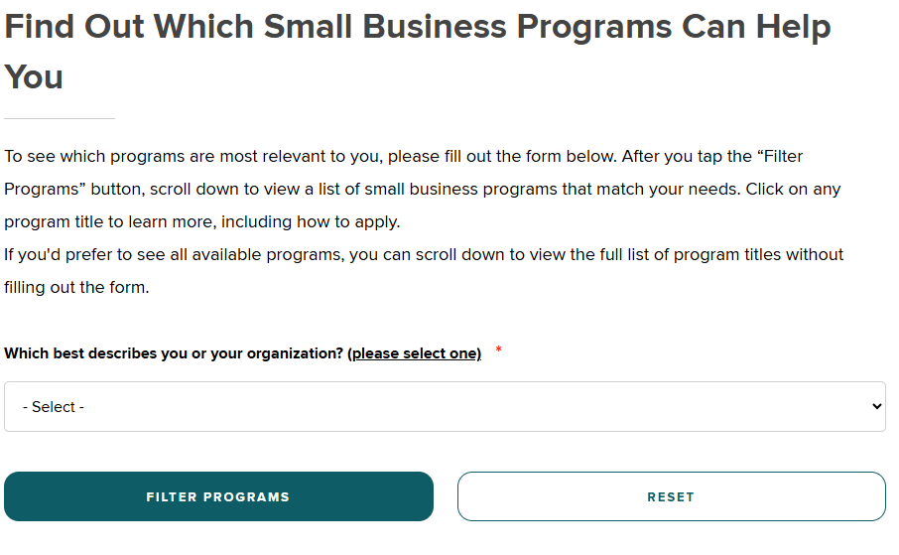
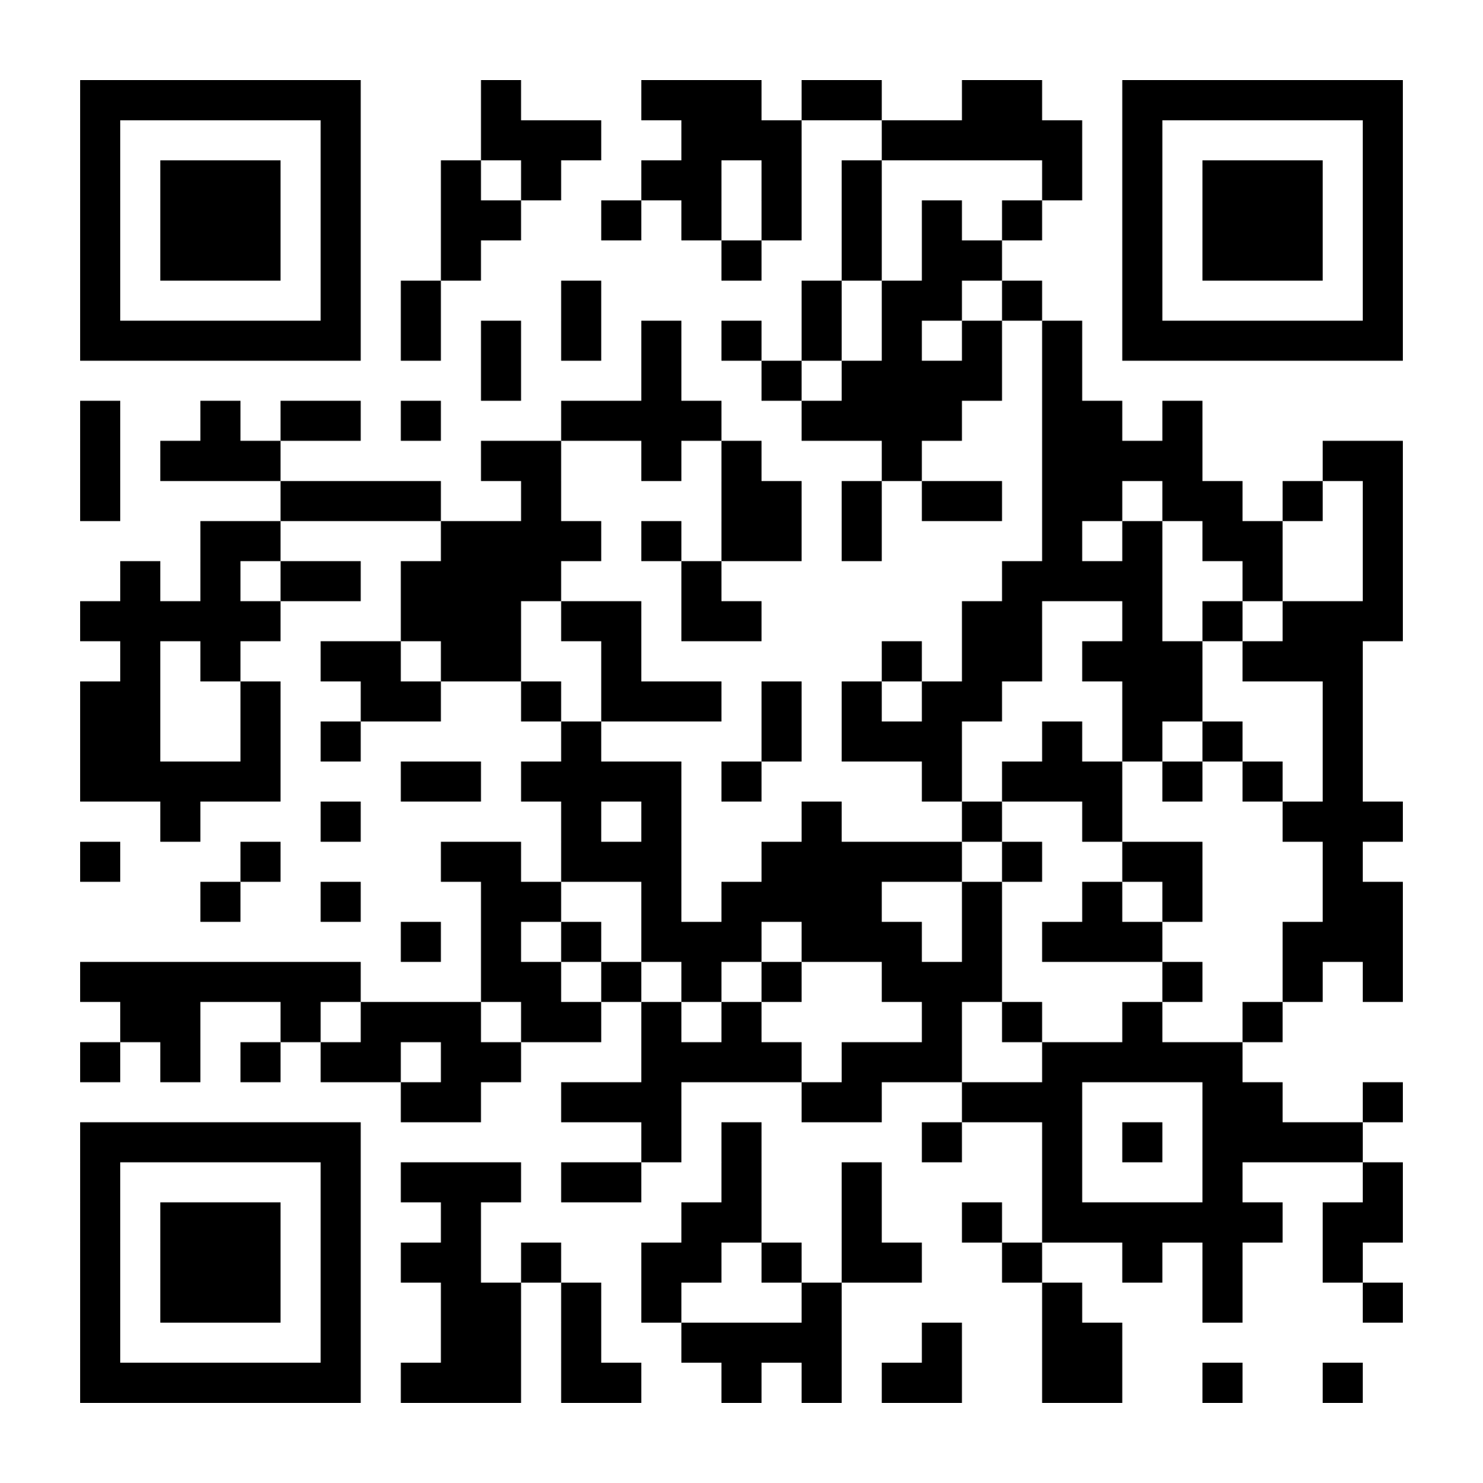
ESD.NY.GOV/SMALLBUSINESS
Stay Connected with
Empire State Development &
Learn More by Scanning the QR Code:
Visit Our Website to

